Slide 1
BEN Community Development
2017-05-15

Slide 2
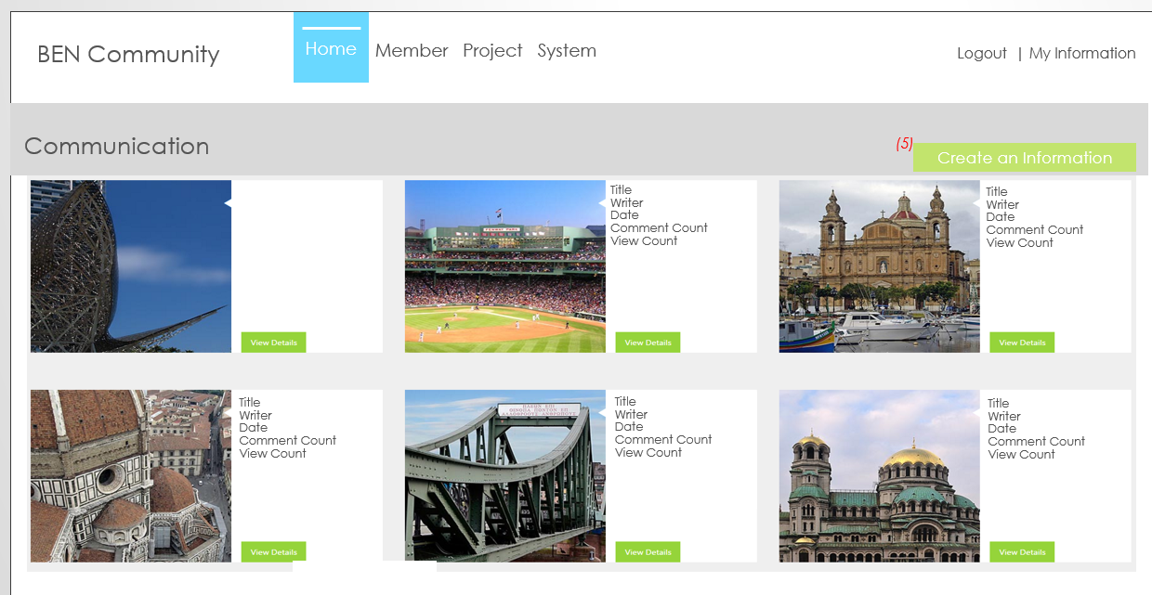
1. Home
Refer Link: http://demos.telerik.com/aspnet-mvc/tripxpert/Destinations
HOME
1. I want home the slid 6
2. U refer PPT file and Check the Menu
BEN Community
Home Member Project System
Logout | My Information
BEN Community_WorkORder_20170501.pptx
This file refer > Slide 6

Slide 3
2 Login Status
HOME
1.
BEN Community
Home Member Project System
Logout | My Information
Status Logout
Login | Create account
Status Login
Full Name | My Information | Logout
All Page Permission check ---- Must be signed in
If you have not logged in > Go to login page

Slide 4

2 My Information
HOME
1. Save button Click “Saved successfully.” Message
2. Cancel button click : “Go to Home. (Not saved)” Yes or No Alter
3. I has change Model “BEN_Community_Model_20170405.xlsx” this file refer U
BEN Community
Home Member Project System
Logout | My Information
My Information
Password Change
Email:
First Name:
Last Name:
Tel:
Address:
Country:
Photo: Specialty Type
SNS Site:
Recommender:
Introduction:
email@email.com
+ Add or Change Photo
changeable
Validation Check (read text)
Career:
Career duration:
Save
Cancel

Slide 5
2 My Information
HOME
1. Save button Click “Saved successfully.” Message
2. Cancel button click : “Go to Home. (Not saved)” Yes or No Alter
BEN Community
Home Member Project System
Logout | My Information
My Information
Password Change
Email:
Current password:
Password
Conform Password
email@email.com
Validation Check
And Minimum password length (6)
Include special characters
Save
Cancel

Slide 6
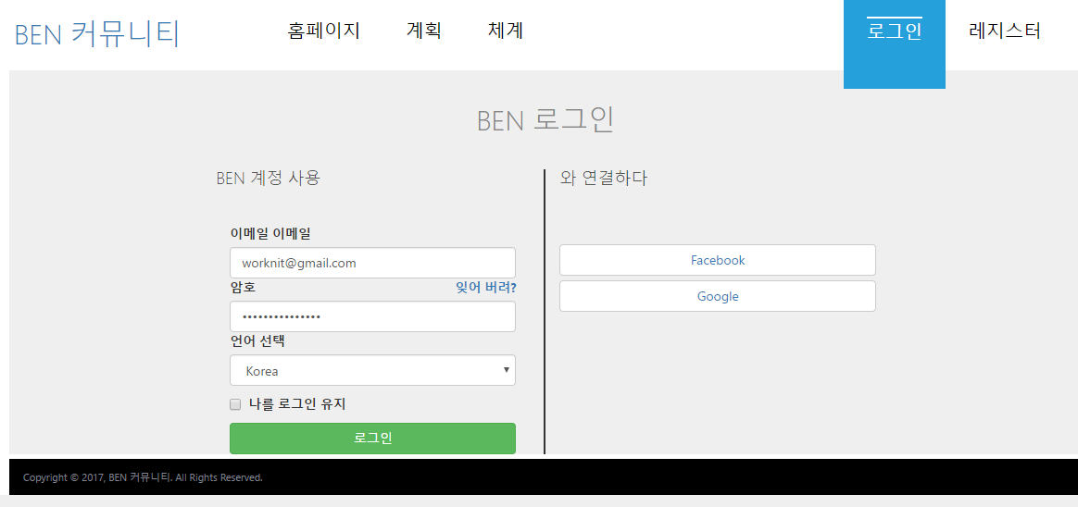
3. Sign up
1.
Email
비밀번호
Keep me logged in

Slide 7
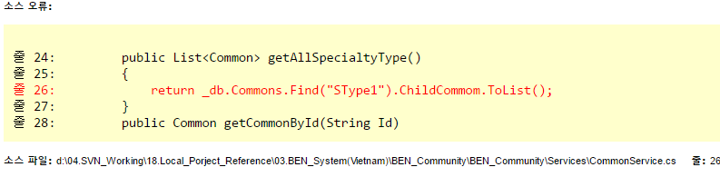
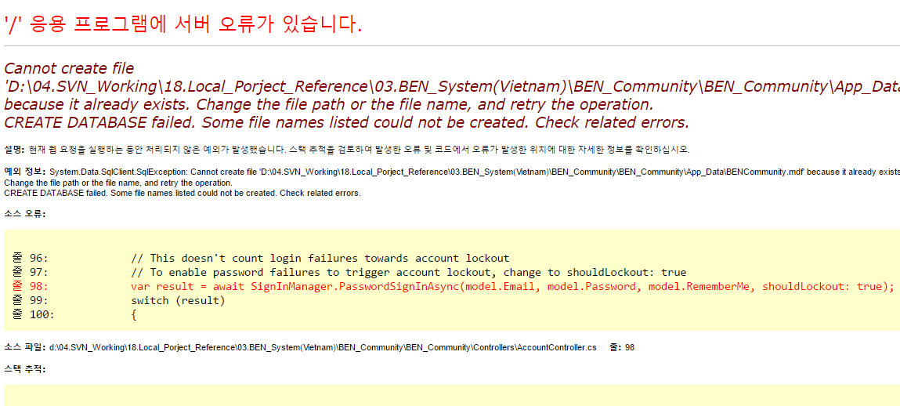
4. Menu And Text Check
1. Language select: default value = Korea display
Check menu – Slide 6
Email
비밀번호
Keep me logged in

Slide 8
5. BEM Membership Registration
1. Add the common code
Add the Common Code
Cascade
Specialty Type
Select
▼
Select
▼
Top Code Name Display
Sub Code Name Display
IT
Embedded developer
Database Engineer
Network Engineer
Application developers
System Engineer
Security Engineer
System Analysis Engineer

Slide 9
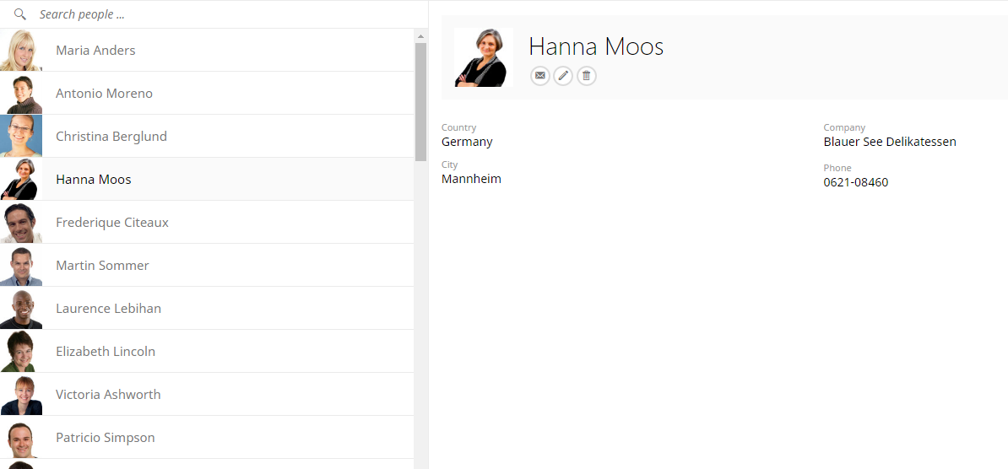
5. Member
Refer Slide: Slide 9
1. Add the member information in Left Grid
2. Add item: Country Name, Specialty Type(Sub Code Name)
Member
Search
(Country, Specialty Type Display)
Name: First Name + space + Last Name
Email: email@email
Country: Korea
Photo: photo.png
SNS Site: www.facebook.com/.,
Recommender: Recommender
Last Login Date: 2017-04-01 17:35
Registration Date: 2017-03-01 09:15
Indroduction: ………………………………………………………………………
……………………………………………………………………………………
………………………………………………………
………………………………………………………

Slide 10
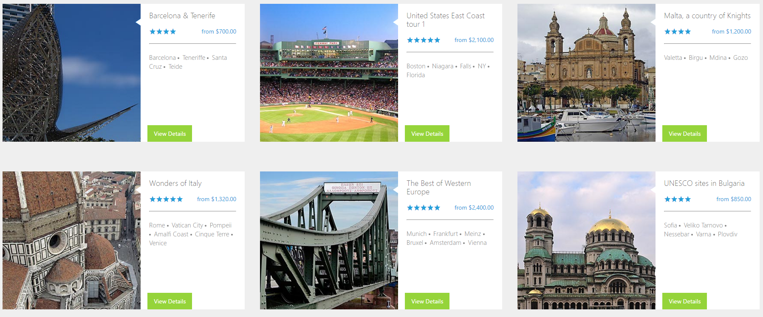
3. Home
Refer Link: http://demos.telerik.com/aspnet-mvc/tripxpert/Destinations
Home
1. Add the search function
2. PM and System Manager is if (Login user = Create User) > attach file, comment, Contents Edit > Possible if( Login User = System Manager )> all contents edit, attach file, comment delete, edit > Possible
BEN Community
Home Member Project System
Logout | My Information
Communication
(5)
Create an Information
Search
Community Name:
search
Title
Writer Date
Comment Count View Count
Title
Writer Date
Comment Count View Count
Title
Writer Date
Comment Count View Count
Title
Writer Date
Comment Count View Count
Title
Writer Date
Comment Count View Count

Slide 11
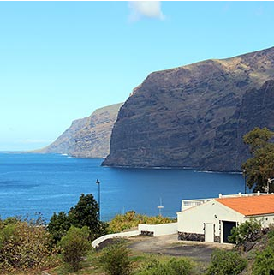

5. Project
Home
1. Number (1) Add 2. (1) click > go to the Project Create View page (Refer the next slide) 3. if (Login User = create user(This contents) → Display or Click possible the Number (2) Link
4. Delete button(link) is if (Login User = create user(This contents) → Display or Click possible the Number (2) Link
BEN Community
Home Member Project System
Full Name | My Information | Logout
Communication
Display Image
Information
Comment
::
File Name
Attach Comment
(1)
Edit| Delete | Create a project
CommentContent…………………………………………………………………………………………………………………………
……………….. ……………….. ……………….. ……………….. ……………….. ……………….. ……………….. ………………..
……………….. ……………….. ……………….. ……………….. ……………….. ………………..
……………………….
……………….. ……………….. ……………….. ……………….. ……………….. ……………….. ………………..
……………………..
……………….. ……………….. ……………….. ……………….. ……………….. ……………….. ……………….. ………………..
……………….. ……………….. ………………..
………………..
………………..
File Name
Attach Comment
File Name Display (File Size)

Slide 12
5. Project
Project
1.
BEN Community
Home Member Project System
Full Name | My Information | Logout
Project
Create Project
Search
Project Name:
Project Status:
Plan Progress Close Drop
search
Project Name
PM Name
Start Date
End Date
Status: Progress
Member: 5
Project Name
PM Name
Start Date
End Date
Status: Progress
Member: 5
Project Name
PM Name
Start Date
End Date
Status: Progress
Member: 5
Project Name
PM Name
Start Date
End Date
Status: Progress
Member: 5
Project Name: tblProject > ProjectName
PM Name: tblProjectMember > ProjectRole = PM > User Full Name Display
Start Date: tblProject > StartDate
End Data: tblProject > StartDate
Status: tblProject > ProjectStatus
Member : select count(*) from tblProjectMember > where ProjectID = this Project ID
** Images : tblProjectAttachment > File(Image) Display select … from tblProjectAttachment where ImgOrOther = 0 (0 is image) and DisplayImgYn = 1
View Detail Click > go to the Next Slide(Detail Page)
Project Name
PM Name
Start Date
End Date
Status: Progress
Member: 5
Project Name
PM Name
Start Date
End Date
Status: Progress
Member: 5
Project Name
PM Name
Start Date
End Date
Status: Progress
Member: 5

Slide 13
5. Project
Project
1. Detail Page
2. Delete Link(Button) is:
if (Login User = create user(This contents) → Display or Click possible the Number (2) Link
3. Table: tblProject, tblProjectMember, tblProjectAttachemnt, tblProjectComment
4. PM and System Manager is if (Login user = PM ) > attach file, comment, Project Edit > Possibel if( Login User = System Manager )> all project edit, attach file, comment delete, edit > Possibel
BEN Community
Home Member Project System
Full Name | My Information | Logout
Project
Project
Go to the list
Display Image
Information
Comment
Member
Project Name Display
Project Period: Start Date ~ End Date ( 300 day)
Category Display
PM Name Display
Project Size Display
Client Name Display (tblProject > CompanyID – tblCompany name Display(
RegDate:
RedEdit:
::
(6)
(6-1)
File Name
Attach Comment
Edit| Delete
Project Contents
……………….. ………………
File Name
Attach Comment
File Name Display (File Size)

Slide 14
5. Project
Project
1. Registration, Edit View page Eidt : if(PM = Login User) > Edit Possibel
2. Button Event - Save: “Do you want to save it?” Yes or No > Yes Select – Save
- Cancel: Do you want move to list? Yes or No
3. Table: tblProject, tblProjectMember, tblProjectAttachemnt, tblProjectComment
BEN Community
Home Member Project System
Full Name | My Information | Logout
Project
Project
Information
Member
Project Name:
Project Period: ~
Category:
Project Size:
Client :
Project Status:
Project Attachment
Save
Cancel
2017-05-01
Select
▼
Select
▼
Select
▼
Select
▼
+ Add files..

Slide 15
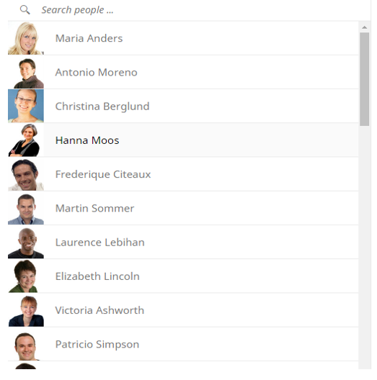
5. Project
Project
1. Registration, Edit View page Eidt : if(PM = Login User) > Edit Possibel
2. Button Event - Save: “Do you want to save it?” Yes or No > Yes Select – Save
- Cancel: Do you want move to list? Yes or No
3. Table: tblProject, tblProjectMember, tblProjectAttachemnt, tblProjectComment
BEN Community
Home Member Project System
Full Name | My Information | Logout
Project
Project
Information
Member
Member
Save
Cancel
Specialty Type
Select
▼
Select
▼
search
(Country, Specialty Type Display)
(Country, Specialty Type Display)
Add
Remove

Slide 16

5. Project
Project
1. Detail Page
2. Delete Link(Button) is:
if (Login User = create user(This contents) → Display or Click possible the Number (2) Link
3.
BEN Community
Home Member Project System
Full Name | My Information | Logout
Project
Project
Save
Cancel
Display Image
Information
Comment
Member
::
(6)
(6-1)
CommentUserName
File Name
Attach Comment
CommentContent…………………………………………………………………………………………
………………..
……………………….
……………………..
ComnetTIme
File Name
Attach Comment
+
Send
File Name Display (File Size)

Slide 17

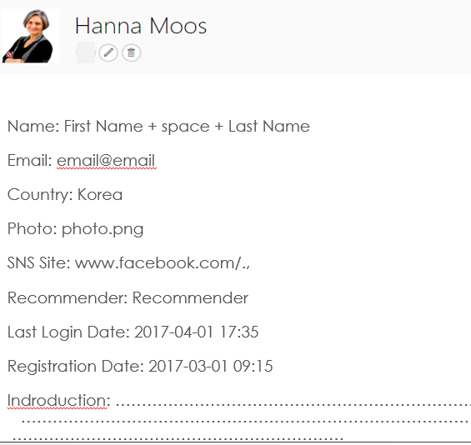
5. Project
Project
1. Detail Page
2. Delete Link(Button) is:
if (Login User = create user(This contents) → Display or Click possible the Number (2) Link
3.
BEN Community
Home Member Project System
Full Name | My Information | Logout
Project
Project
Save
Cancel
Display Image
Information
Comment
Member
PM: PM Name
PercentInProject %
PL: Name
PercentInProject %
Development: Name
PercentInProject %

Slide 18
5. Project
System
1. Detail Page
2. Delete Link(Button) is:
if (Login User = create user(This contents) → Display or Click possible the Number (2) Link
3.
BEN Community
Home Member Project System
Full Name | My Information | Logout
System
사용자관리
공통코드관리
거래처관리
사용자관리
No | Email | First Name | Last Name | Specialty Type | CareerInfo | CareerDuration | Recommender | LastLoginDate
 |  |  |  |  |  |  |  |  | Edit

